Slide 1
Lana Thompson
Health Savings Accounts
(312-909-2975)
Version 11/15/2021

Slide 2

What is a Health Savings Account (HSA)?
An HSA is an account that gives a consumer more control over saving and paying for healthcare expenses. Designed to work with a High Deductible Health Plan (HDHP), the HSA helps consumers prepare for known and unknown needs, now and in the future.
HSA
Advantages
HSAs are triple tax advantaged:
  Contributions you make are deductible and account balances grow tax-free¹
  Interest earned is tax-free¹
  Withdrawals to pay for qualified medical expenses are tax-free¹
Balances roll over from year to year
Funds never expire. They rollover even with a new job or HSA qualified health plan
HSA funds can be invested², and any earnings grow tax-free
1 HSA contributions and earnings are generally not subject to federal taxes, but may be subject to state taxes. BMO Harris does not provide tax or legal advice. You should consult with your own tax and legal professional.
2 Investments are NOT FDIC INSURED – NOT BANK GUARANTEED – NOT A DEPOSIT – MAY LOSE VALUE.

Slide 3







Advantages of an HSA
Specialized bank account just for healthcare expenses
Designed to pair with an HSA-qualified health plan
Funds never expire and roll over, even if you switch jobs or insurance
HSA funds can be invested, and any earnings grow tax-free
Tax-free contributions, interest, and spending on qualified medical expenses
Save and pay tax-free for out-of-pocket expenses

Slide 4

What is a qualified medical expense?
HSAs are designed to be used for medical expenses. So, what are examples of qualified medical expenses? The list is quite long. Below are just a few of the common types of expenses consumers use their HSAs for.
The IRS determines what is a qualified medical expense and the list is updated every year. You can find the most recent IRS publication here.

Slide 5

Not all HSAs are created equal!
The BMO HSA, delivered by Lively is a great choice for your company.
Dedicated customer service – a U.S.-based dedicated customer success manager to help from A to Z year-round, regardless of size
Comprehensive dashboard – an intuitive online dashboard to easily manage tasks while not losing sight of the big picture
Easy account opening – employees receive an e-mail and can quickly open their new account on their own device 100% paper free
Multiple upload options – create new accounts by manual entry, batch spreadsheet upload or integration to HR software
Batch contribution - easily fund accounts with one ACH, no need to fund each individual account
Reporting – easily create reports to monitor employee enrollment, contributions, and more
Simplified pricing – a flat monthly fee based on the number of enrolled accounts
BMO Health Savings Account delivered by Lively is provided by Lively Inc and is subject to their approval. Accounts are provided by Lively Inc., which is not affiliated with BMO Harris Bank.

Slide 6

Not all HSAs are created equal!
The BMO HSA, delivered by Lively is a great choice your employees
Fee-free – no monthly fee or minimum balance requirement. As well as no fees for common items like new debit cards or paper statements.
Account management dashboard – easily manage all aspects of the HSA via Lively’s website or mobile app
HSA debit card – easily pay for qualified medical expenses directly at the point of sale
Deductible tracker – connect a health plan and track spending against your deductible
Expense scout – automatically catch eligible expenses from linked accounts and cards to identify potential eligible expenses for reimbursement
Reimbursable bank – easily link any bank account to manage reimbursements
Investment options – the ability to invest HSA funds (fees may apply and funds are not FDIC insured)
Access to Lively’s HSA experts – a knowledgeable support team is always within reach for any questions

Slide 7
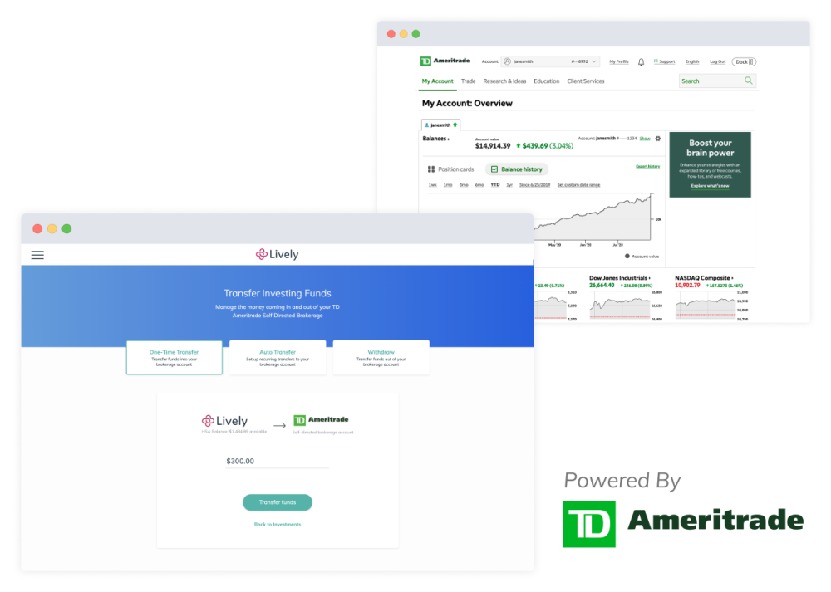
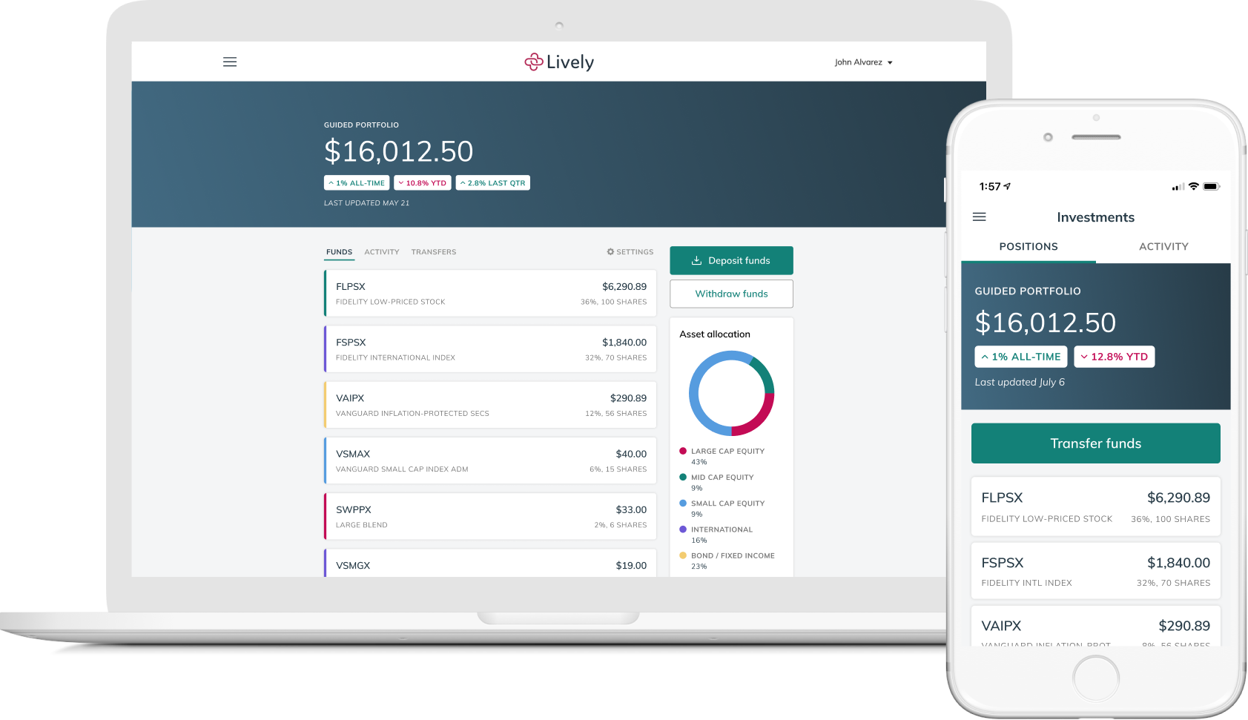
Investment Access
With the BMO HSA, delivered by Lively give your employees access to robust, personalized investment solutions with the opportunity to grow their HSA funds even more. Investing can start right away as soon as the account is funded, and performance can be easily monitored from the Lively dashboard online or through the Lively mobile app.
Self-Directed Brokerage Account through TD Ameritrade
HSA Guided Portfolio through Devenir
Access a complete range of investment options
Individual stocks, bonds, commission-free ETFs, and more than 13,000 mutual funds
$0 commissions for online trading of US exchange listed stocks
Personalized suggestions tailored to your risk preferences and
time horizons
Automatic rebalancing helps ensure the portfolio stays on track over time
0.50% annual fee based on invested assets
Investments are NOT FDIC INSURED – NOT BANK GUARANTEED – NOT A DEPOSIT – MAY LOSE VALUE.

Slide 8


Eligibility
Requirements to be eligible for and to contribute to an HSA:
You are covered under a qualified HDHP
You are not covered by another health plan that is not a HDHP¹
You are not enrolled for Medicare benefits
You are not eligible to be claimed as a dependent on another individual’s tax return
You or your spouse are not contributing to a traditional health FSA or Health Reimbursement Account (HRA) which would make you ineligible to contribute to an HSA. Contributing to a limited-purpose health FSA or HRA will not prevent HSA eligibility.
¹ Certain exceptions may apply.

Slide 9
Contributions
Contributions can be made by the employer, the individual, a family member or any other individual
Maximum Contribution Amounts defined by the IRS:
Tax Year | Annual Contribution Limits |  | Catch-up contribution(s) available for ages 55 or older | Maximum contribution limit with catch-up contribution for ages 55 or older
 | Self | Family |  | Self | Family
2021 | $3,600 | $7,200 | $1,000 | $4,600 | $8,200
2022 | $3,650 | $7,300 | $1,000 | $4,650 | $8,300
These amounts are based on HDHP Coverage type and are indexed annually for inflation.

Slide 10

Distribution Rules
Distributions are tax free when used to pay for qualified medical expenses
Distributions can pay for medical expenses for spouse and dependents
State tax implications vary by state.
HSA funds can’t be used to pay HDHP premiums or other comprehensive health insurance premiums
Exceptions:
  COBRA continuation coverage
  Health plan coverage while unemployed
  Long-term care insurance premiums
  Medicare premiums (Part A, Part B, Medicare HMOs)

Slide 11
The advantages of working with BMO Harris
We have the capabilities you need to help your company succeed and help your employees secure their financial futures
BMO Harris
Bank at Work
BMO Harris Bank at Work is a dynamic workplace program that brings your employees
not only a full-featured suite of banking products and services, but also provides for
onsite and virtual financial education seminars.
At no cost to the company or the employee.
BMO Harris
Premier Services
Provides the individual support and attention your employees need to address the unique complexities associated with achieving a higher level of financial success
Wealth Management
Services*
For affluent individuals and families looking to preserve and protect their wealth
Solutions include: Financial Planning, Personal Trust and Investment Management, Private Banking, Trust and Estate Settlement, Business Succession Planning
*BMO Wealth Management is a brand name that refers to BMO Harris Bank N.A. and certain of its affiliates that provide certain investment, investment advisory, trust, banking, securities, insurance and brokerage products and services. Securities, insurance and investment products are NOT FDIC INSURED – NOT BANK GUARANTEED – NOT A DEPOSIT – MAY LOSE VALUE.

